Slide 1
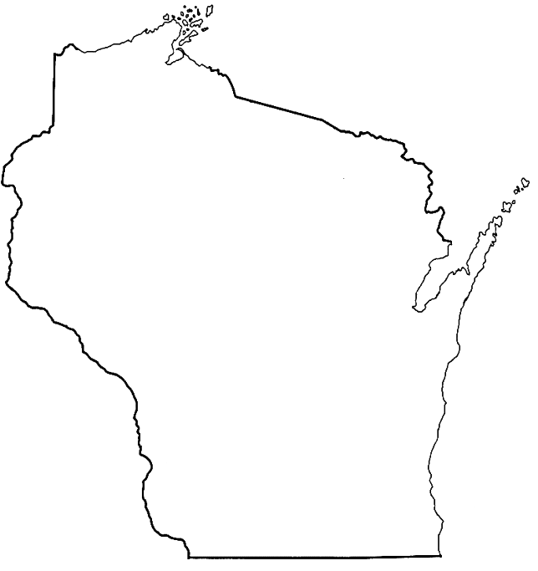
Wisconsin Breast Cancer Diagnosis Analysis
Analysis by: Om Gor, Matt Khosrowabadi, Svetlana Voda

Slide 2

Research Question
Variable Selection
LASSO (L1 Regularization)
Predictive Modeling
LASSO Regression
KNN
Naive Bayes
SVM
Decision Tree
Random Forest
Problem: The goal of this analysis is to develop a predictive model capable of accurately classifying tumors as benign or malignant.
Solution: Implement a machine learning pipeline using LASSO for feature selection, followed by training KNN, Naive Bayes, SVM, Decision Tree classifiers. Optimize these models to maximize accuracy and reliability for tumor classification.
Notes:
Svetlana

Slide 3
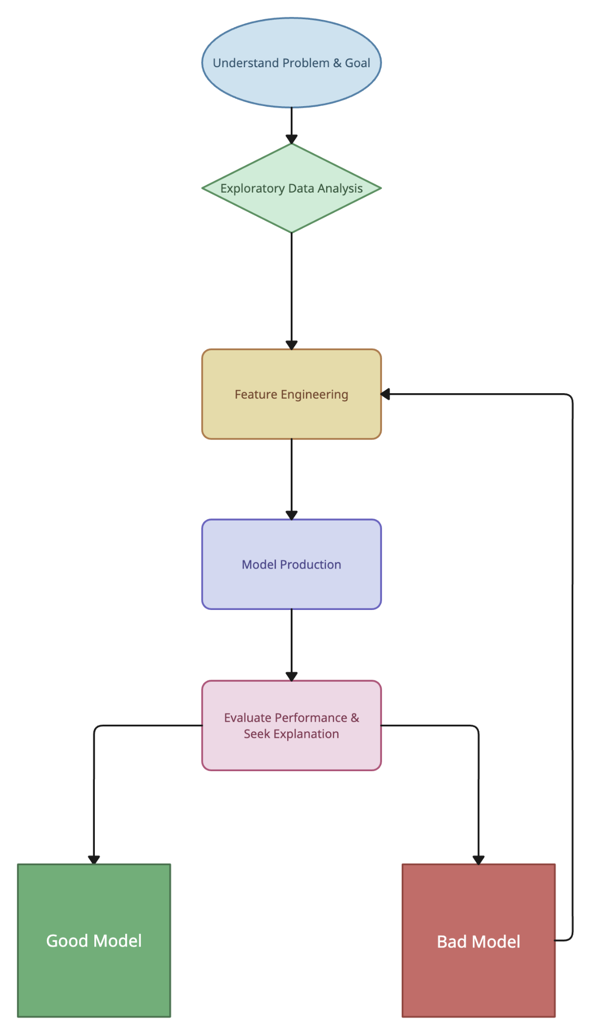
Our Approach
Exploratory Data Analysis (EDA)
Understand dataset structure, identify key patterns, and handle missing values.
Feature Selection with Lasso Regression
Identify features most correlated with the binary target to reduce dimensionality.
Model Implementation
Algorithms Used:
K-Nearest Neighbors (KNN)
Naïve Bayes
Support Vector Machine (SVM)
Decision Tree
Random Forest
Evaluate performance to identify the best model.
Notes:
Svetlana

Slide 4

The Data
Data Overview:
569 Rows → Patients
31 Columns → Attributes: ID Number, Diagnosis, Radius, Texture, Perimeter, Area, Smoothness, Compactness, Concavity, Concave Points, Symmetry, Fractional Dimension (mean, standard error, worst)
Data Cleaning + Preprocessing:
Removed ID Number
Checked for missing values → No missing values
Checked for null values → No null values
Created standardized data after EDA
Notes:
Om Gor: Moving on to the data, our dataset consist of 569 rows, each representing a patient and 31 columns. The attributes of the columns each containing mean, standard error and worst value. Some of the attributes are id number, diagnosis, radius, texture, perimeter, area, and etc. For Data Cleaning and Processing, we removed the ID number column as it was not relevant for our analysis, checked for missing values and found no missing values, checked for null values and found no null values as well and we standardized the data after conducting the EDA.

Slide 5

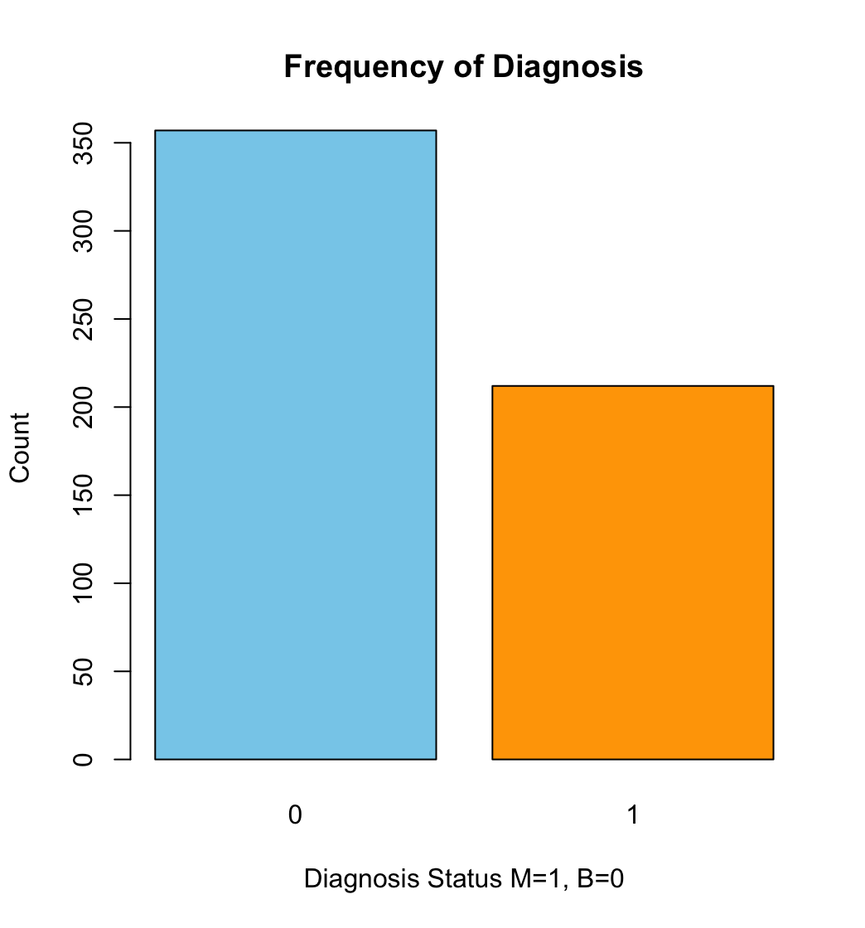
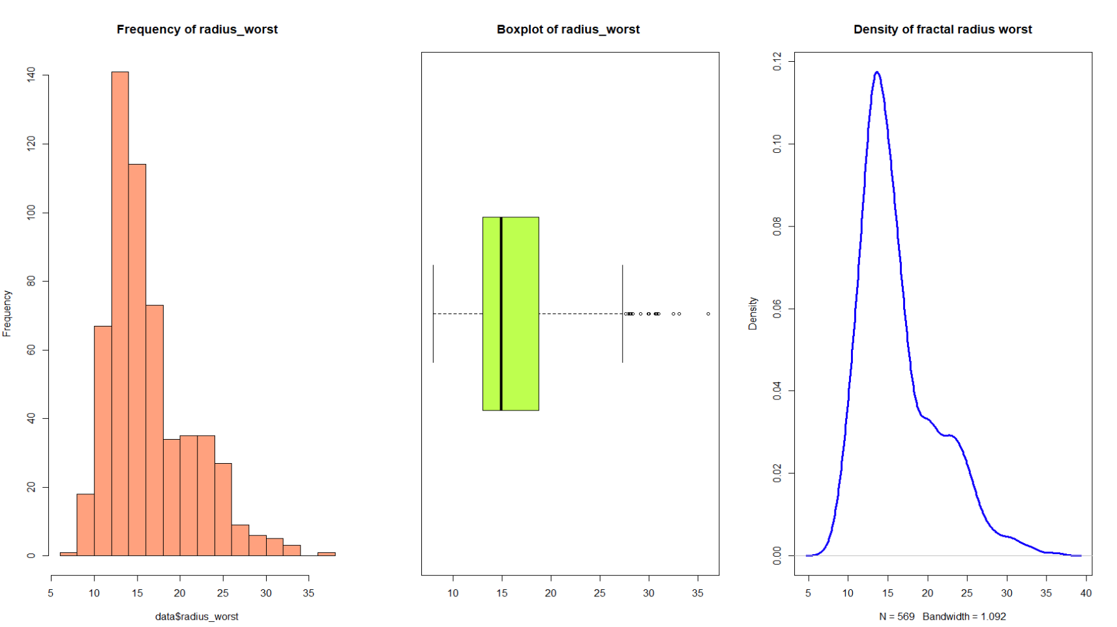
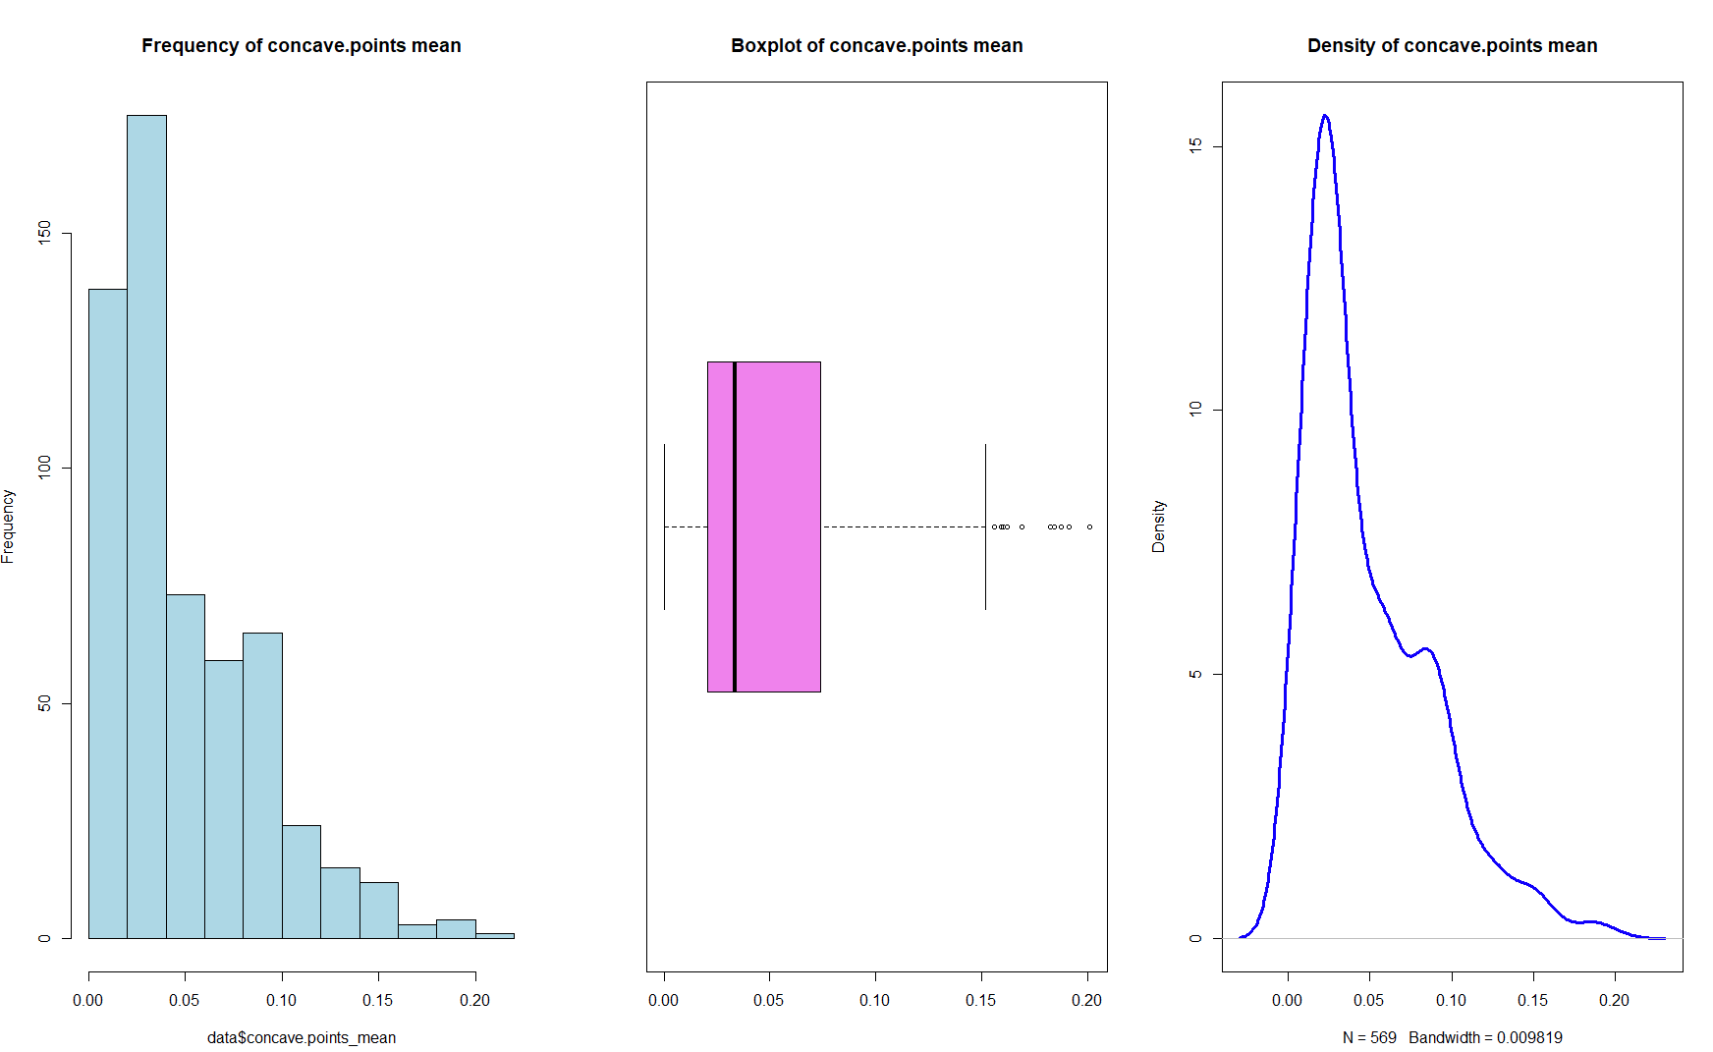
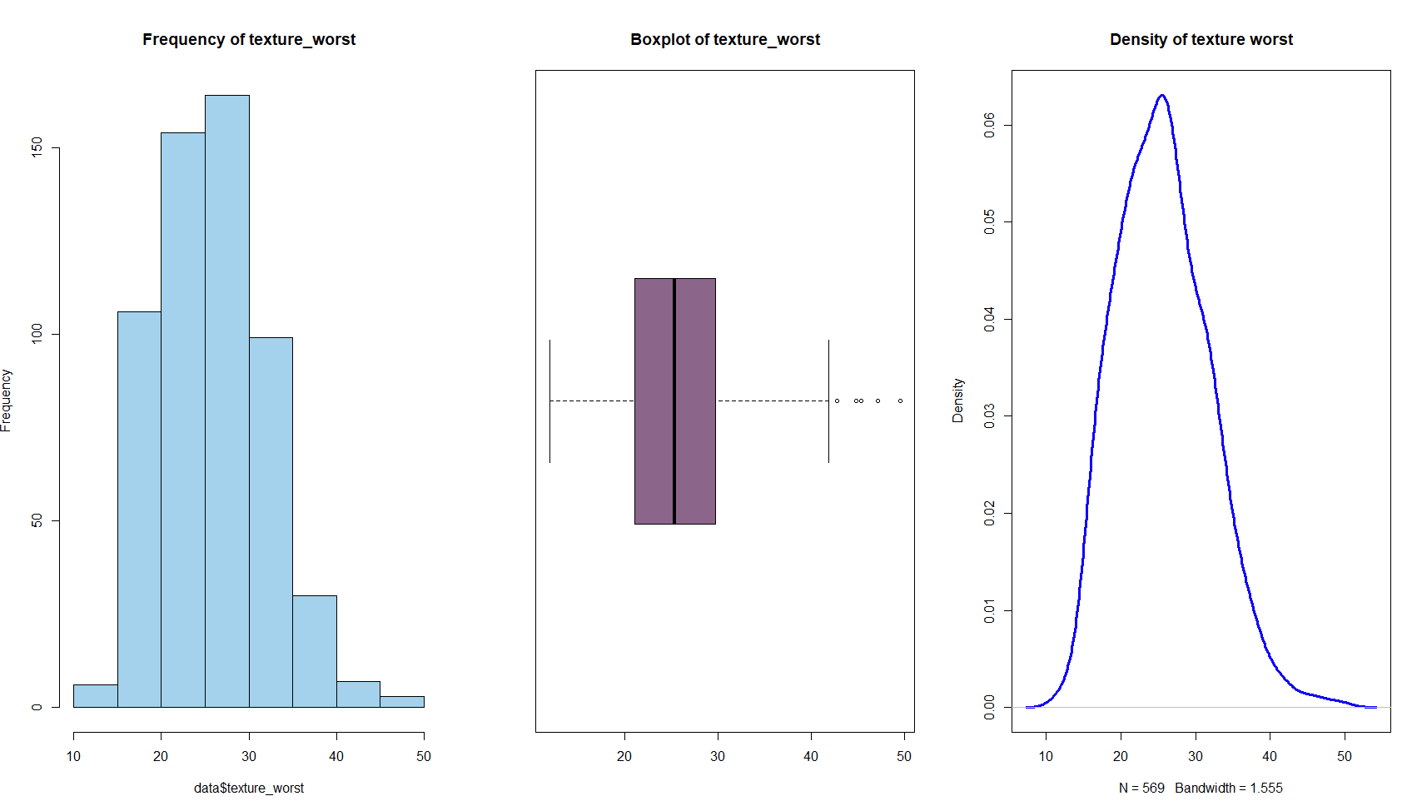
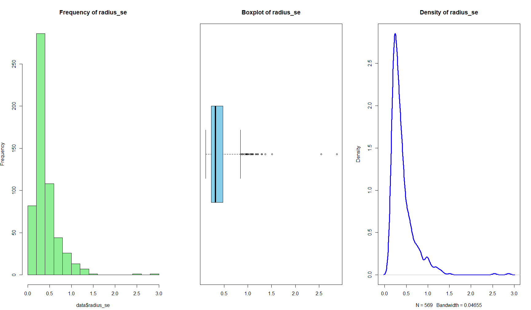
Exploratory Data Analysis
Notes:
This slide represents the Exploratory Data Analysis, or EDA, which is an important first step in understanding the dataset before any modeling or predictions are made. It helps us analyze patterns, distributions, and relationships within the data. Let me walk you through what we see here."
"On the left-hand side, we have the bar chart titled 'Frequency of Diagnosis.' This chart shows the distribution of the diagnosis status in our dataset. Here, 0 represents benign cases (B), while 1 represents malignant cases (M). As we can see, the blue bar for benign cases is much taller, meaning we have more benign cases compared to malignant cases, shown in orange. This indicates a class imbalance that we need to keep in mind during analysis."
"On the right side, we see a series of smaller charts, which give us insights into the statistical properties of various features in the dataset."
"First, the histograms in the first column show the frequency distributions of these features. This helps us understand how the values are spread and whether they are concentrated around certain ranges."
"In the second column, we have box plots, which give us a summary of the spread and central tendencies for the features. These are helpful in identifying outliers and understanding the variability in the data."
"Finally, the density plots in the third column provide a smooth representation of the data's probability distribution. These are particularly useful for detecting skewness or peaks in the data
Right-Skewness: Right-skewed distributions can introduce bias into models, especially those sensitive to the range of values, like logistic regression, linear regression, or distance-based models (e.g., K-Nearest Neighbors, SVMs).

Slide 6
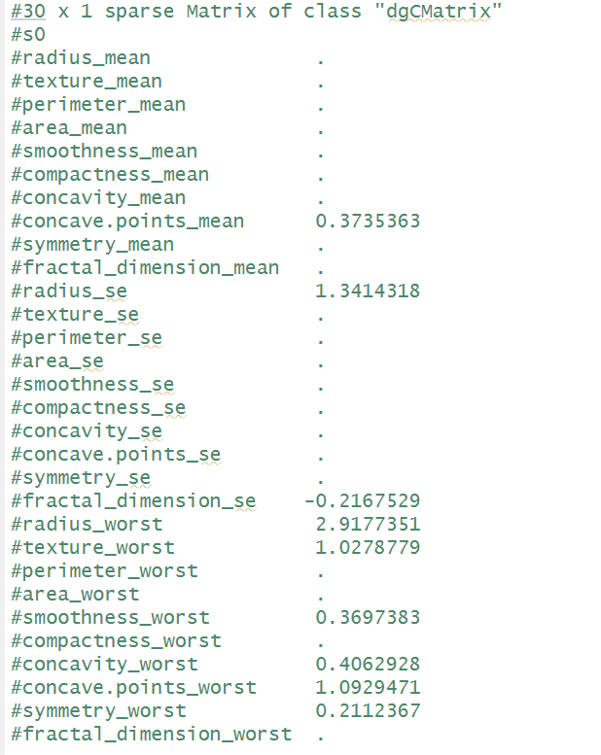
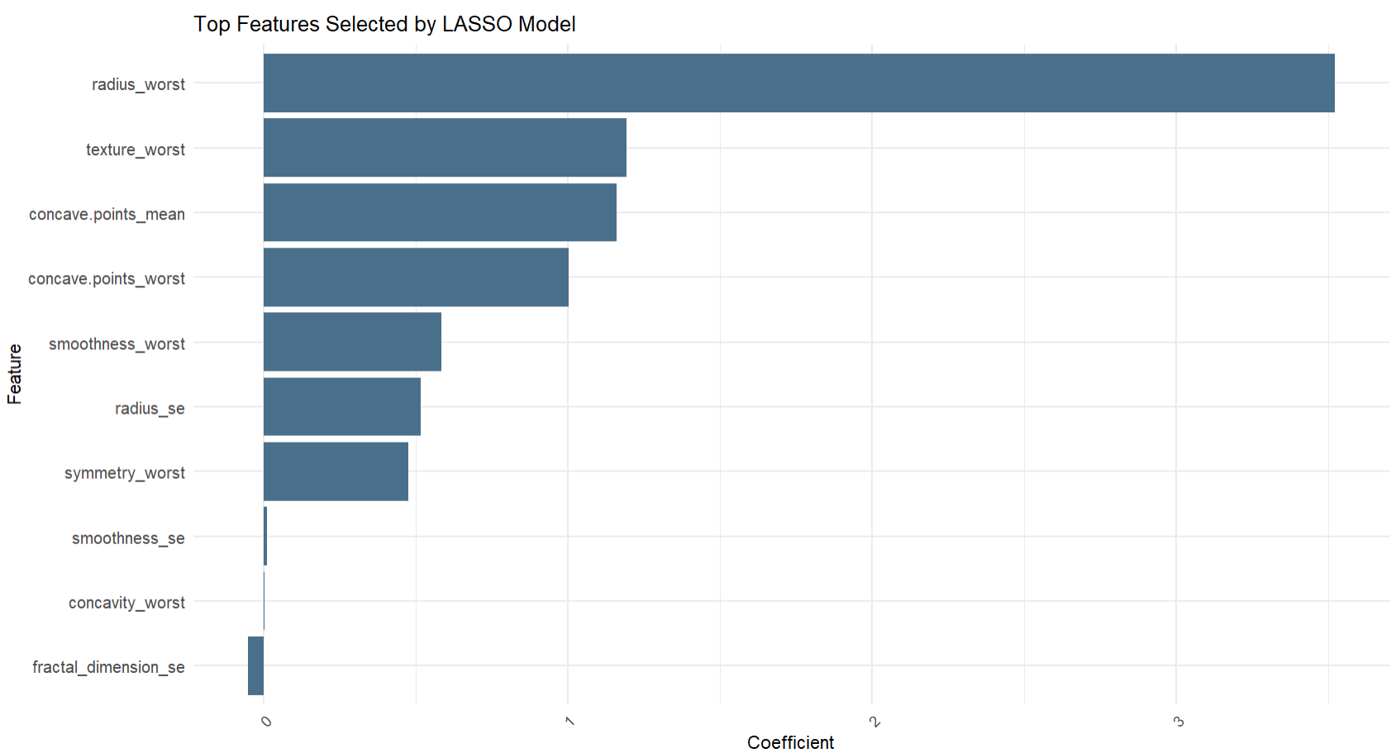
Feature Selection using LASSO
Identify the best features for classification using LASSO regression by:
Performed cross-validation to find the optimal lambda (λ=0.0077).
Fitted LASSO with binomial family for classification.
Notes:
Om Gor: When conducting EDA on the dataset, we found high collinearity between the predictors. We used Lasso to simplify the dataset by eliminating redundant variables to focus on the important predictors and to prevent overfitting in the models. Out of the 30 predictors, LASSO reduced the model down to 9 predictor variables seen in the plot. On the plot on the left we see the values with the numbers are the ones deemed relevant by LASSO, and the ones that are not there are seen as insignificant by the LASSO model. On the right plot it shows the top features selected by the LASSO Model. The 3 top features are radius_worst, texture_worst, and concave_point means. We performed cross-validation to find the optimal lambda for the model which was 0.0077. We fit the Lasso with binomial family for classification and these 9 features are what we used for the models.

Slide 7
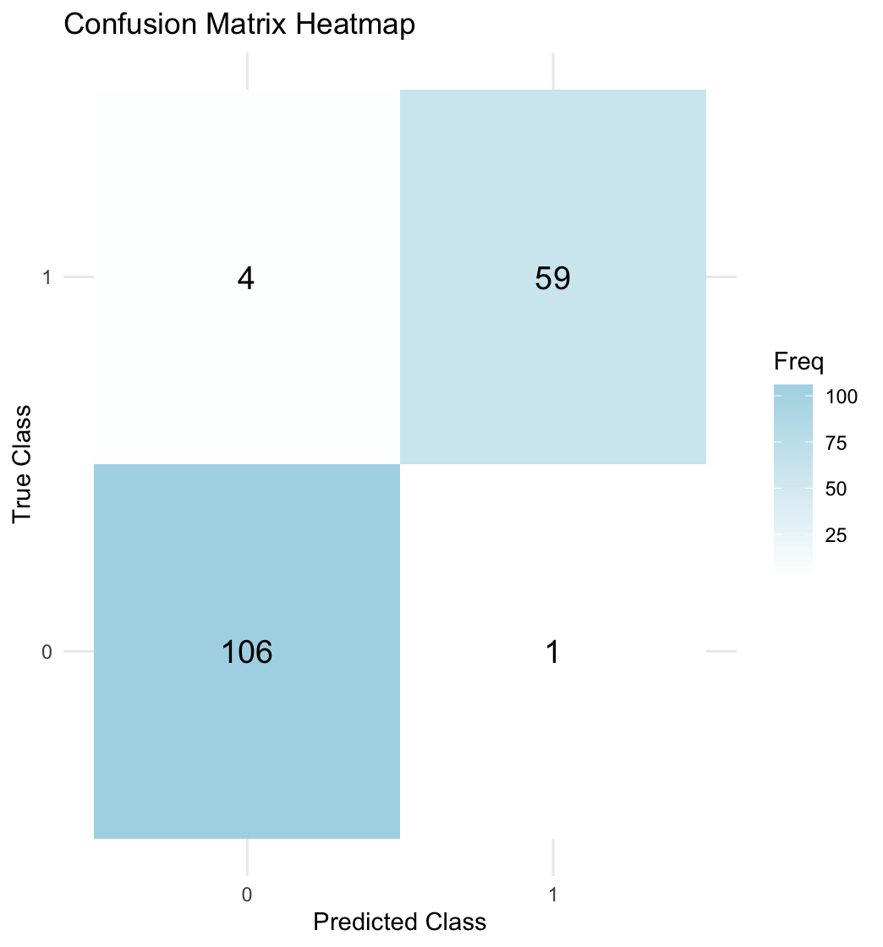
Lasso Regression
Objective: Classify data using LASSO, optimized through feature selection and tuning to identify the most relevant predictors.
Optimization:
Optimal features determined through regularization to enhance model interpretability and reduce overfitting.
Best lambda from cross validation: 0.0077
Performance Metrics:
Accuracy: 0.9706
Sensitivity (Recall) : 0.9365
Precision: 0.9833
F1- score: 0.9593
Notes:
Om Gor: After using LASSO to select optimal features through regularization, we used those 9 predictor values and evaluated the model. We had 59 true positive and 106 true negatives. We got an high accuracy of 97.06% and the F1-score of 0.95 which indicates a good balance between precision and recall.

Slide 8
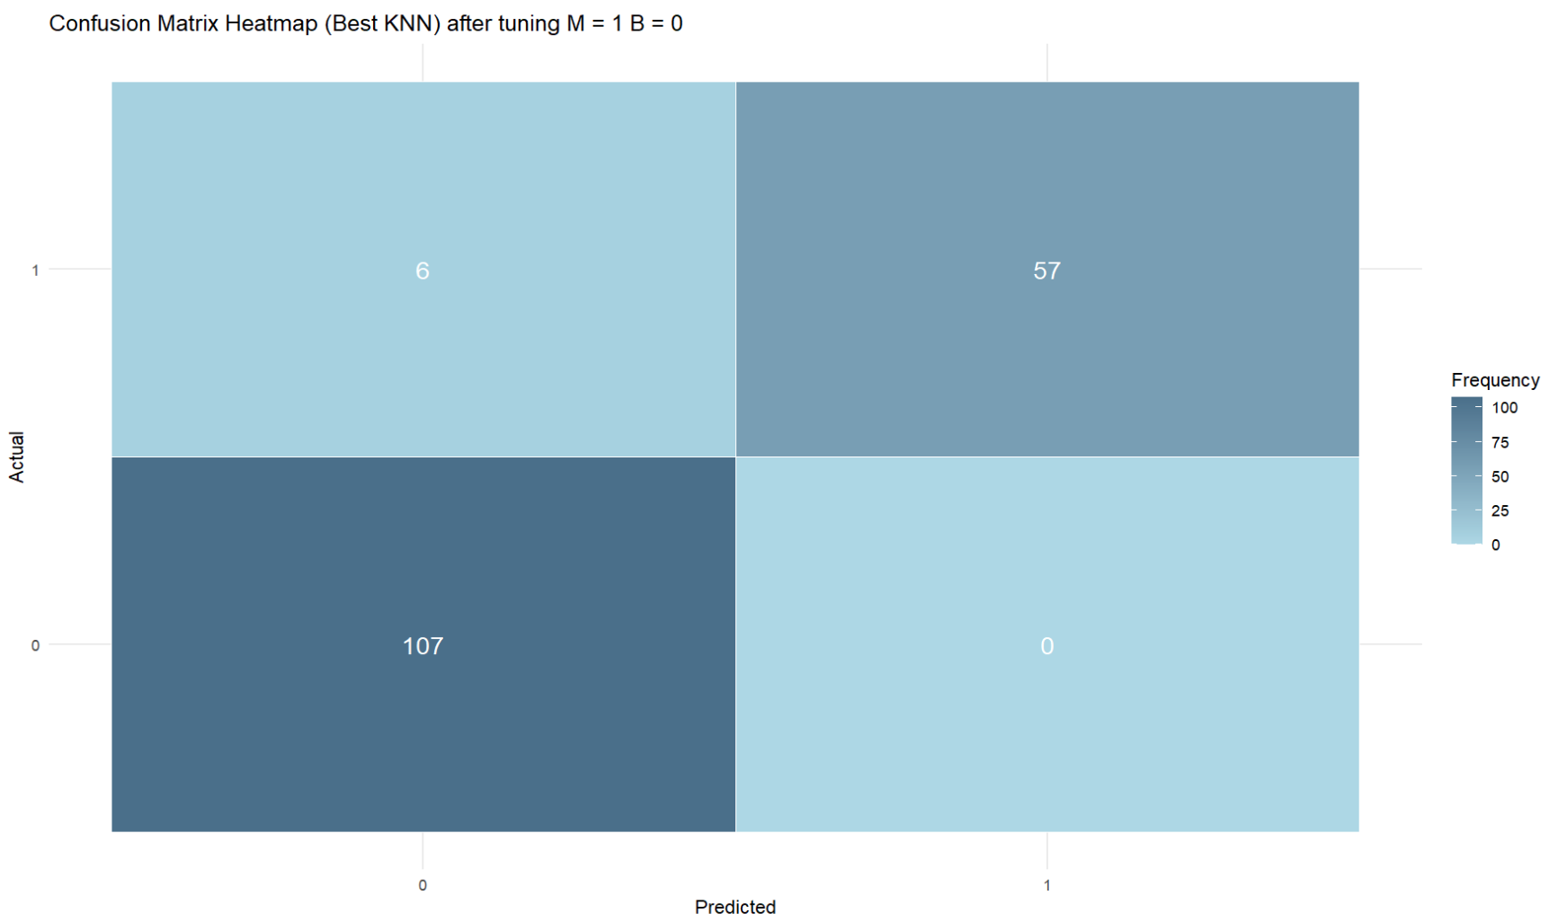
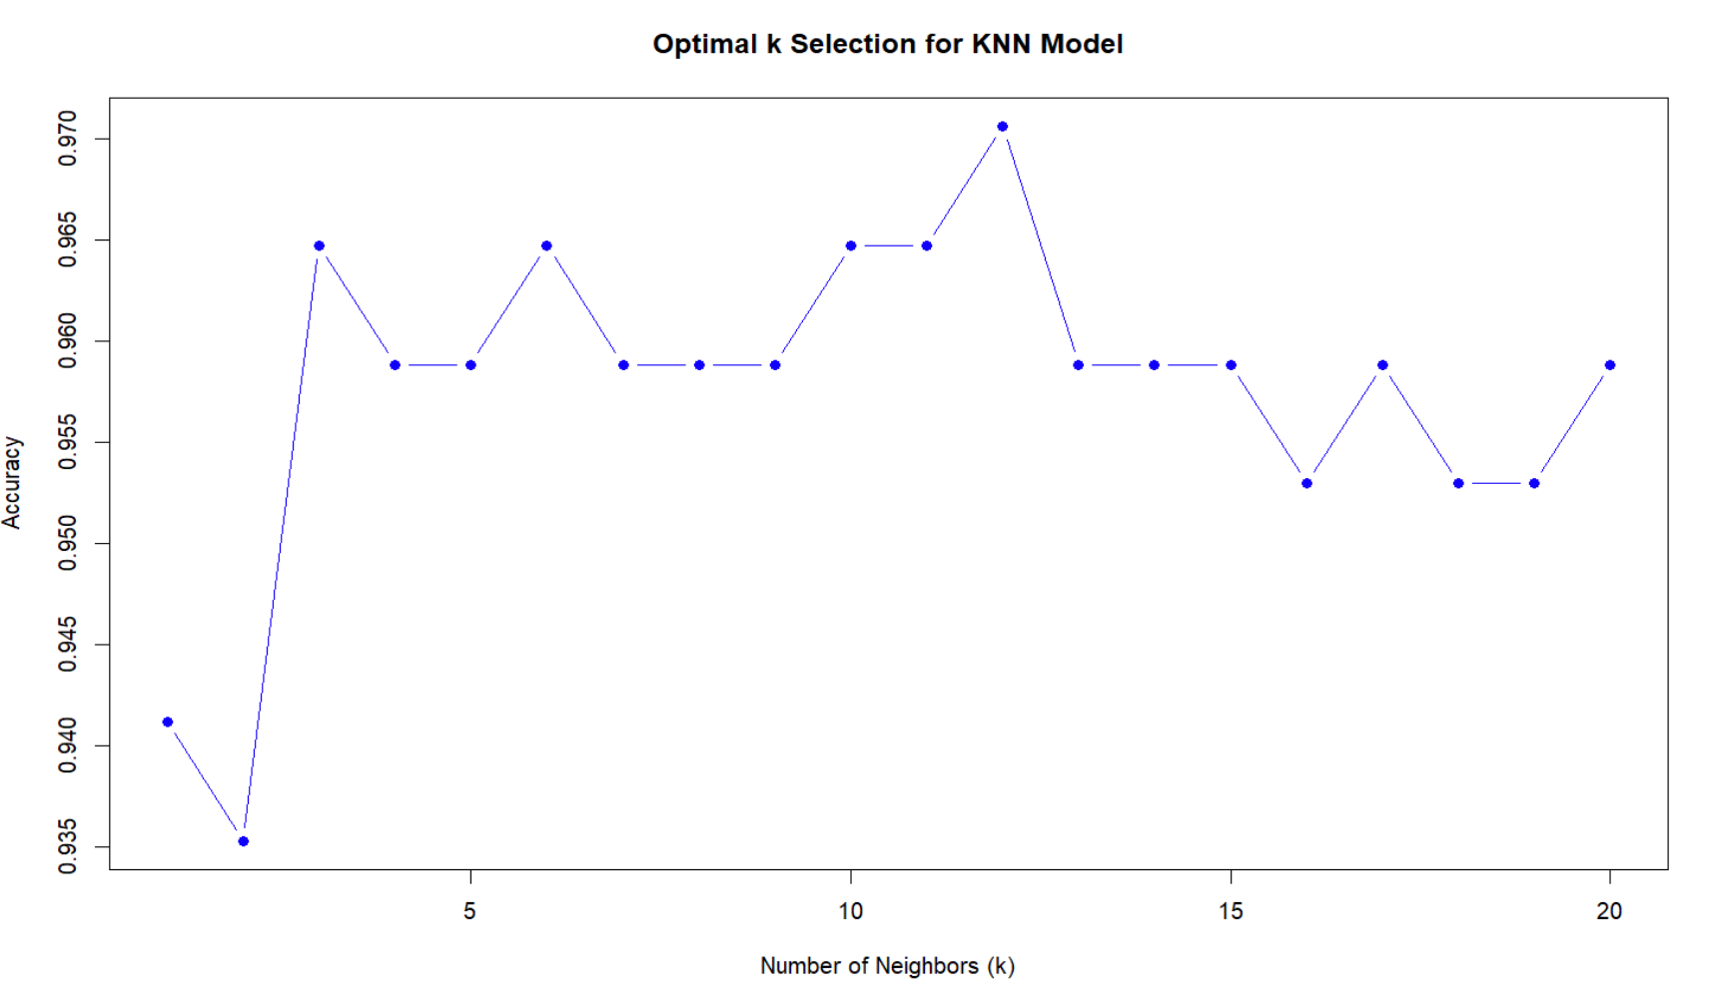
KNN Model :
Objective: Classify data using K-Nearest Neighbors (KNN) with features selected by LASSO.
Optimization:
Best K-value: 12
Performance Metrics:
Accuracy: 0.9647059
Sensitivity (Recall) : 0.9047619
Precision: 1
F1- score: 0.95
Notes:
Svetlana : We used the K-Nearest Neighbors (KNN) model to classify our data, with features selected through LASSO optimization. After testing different values, we found the best K-value to be 12. The model performed well, with an accuracy of 96.47%, meaning it correctly predicted almost 97% of the cases. It also had a high sensitivity of 90.48%, showing it is effective at identifying positive cases. The precision was perfect at 1, meaning there were no false positives, and the F1-score of 0.95 indicates a good balance between precision and recall."

Slide 9
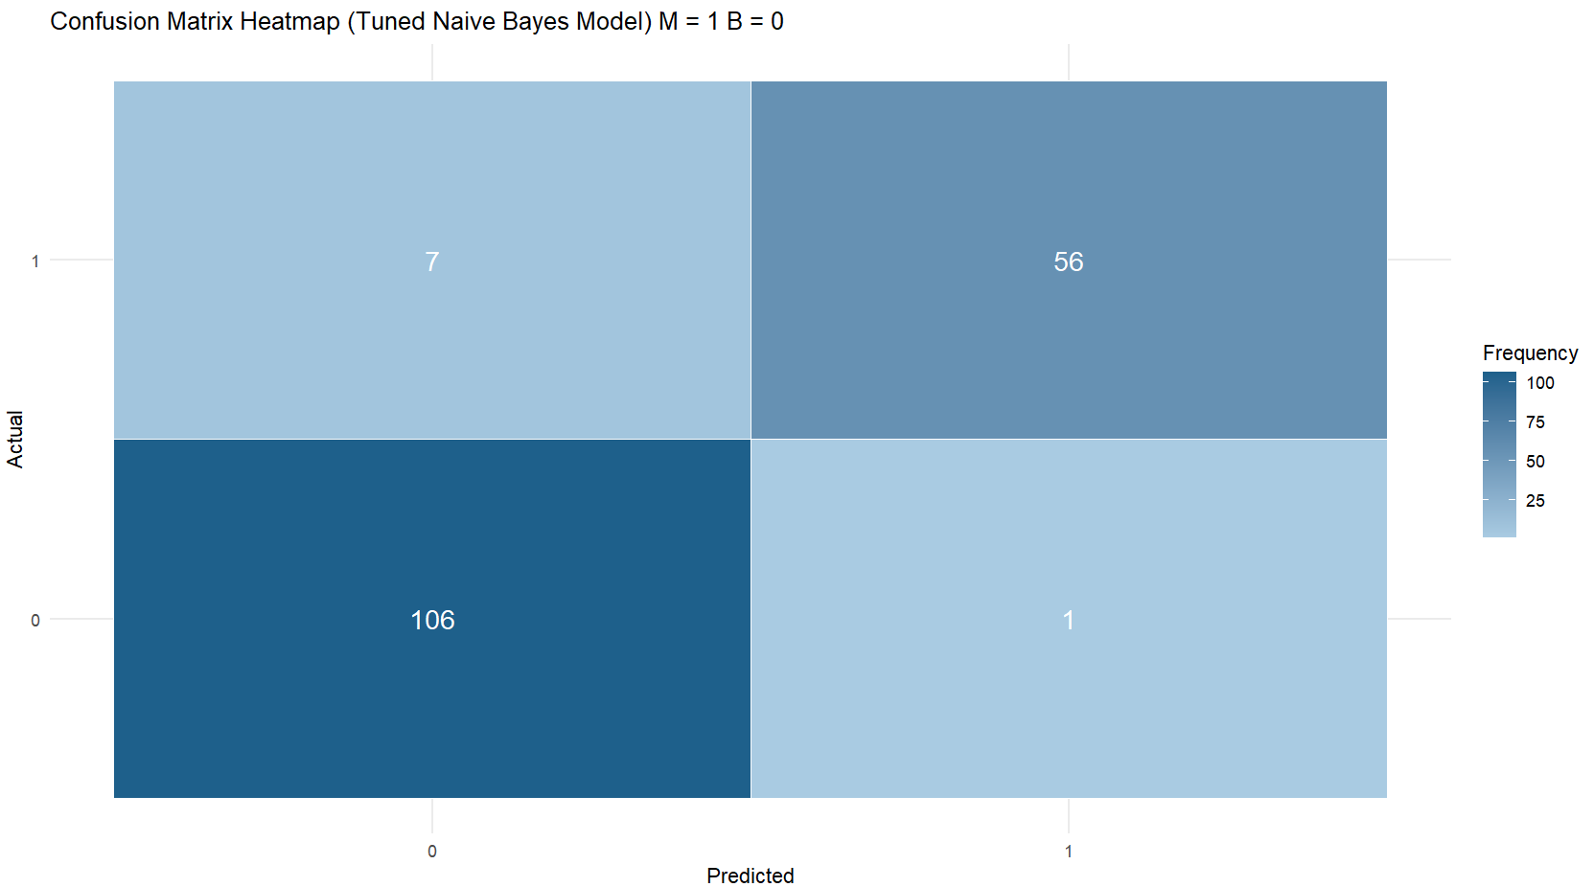
Naive Bayes
Objective: Classify data using Naive Bayes, optimized with hyperparameters for enhanced performance metrics
Optimization:
Laplace = 0, usekernel = FALSE, adjust =1
Performance Metrics:
Accuracy: 0.9529412
Sensitivity (Recall) : 0.9824561
Precision: 0.8888889
F1- score: 0.9333333
Notes:
We used the Naive Bayes model to classify our data, selecting important features through LASSO optimization. After testing, we found the best settings for the model were a Laplace value of 0, with usekernel set to FALSE and adjust set to 1. The model worked well, achieving an accuracy of 95.3%, meaning it correctly predicted about 95% of cases. It also has high sensitivity (0.9825), which helps it avoid missing important cases. However, its precision is a bit lower (0.8889), showing there is a balance between sensitivity and precision. The F1-score of 0.9333 indicates that the model strikes a good balance between these two factors.
Sensitivity (also called Recall) measures how well the model identifies positive cases. It tells us the proportion of actual positives that the model correctly predicts. High sensitivity is important when we want to minimize false negatives, which are cases where the model fails to identify a positive outcome (e.g., missing a sick patient when diagnosing a disease).
F1-score is the balance between precision and recall. It’s useful when you care about both correctly identifying positive cases (recall) and avoiding false positives (precision). F1 is particularly important when you want to strike a balance between the two, as it combines both into one number. A high F1-score indicates that the model performs well in both precision and recall.

Slide 10
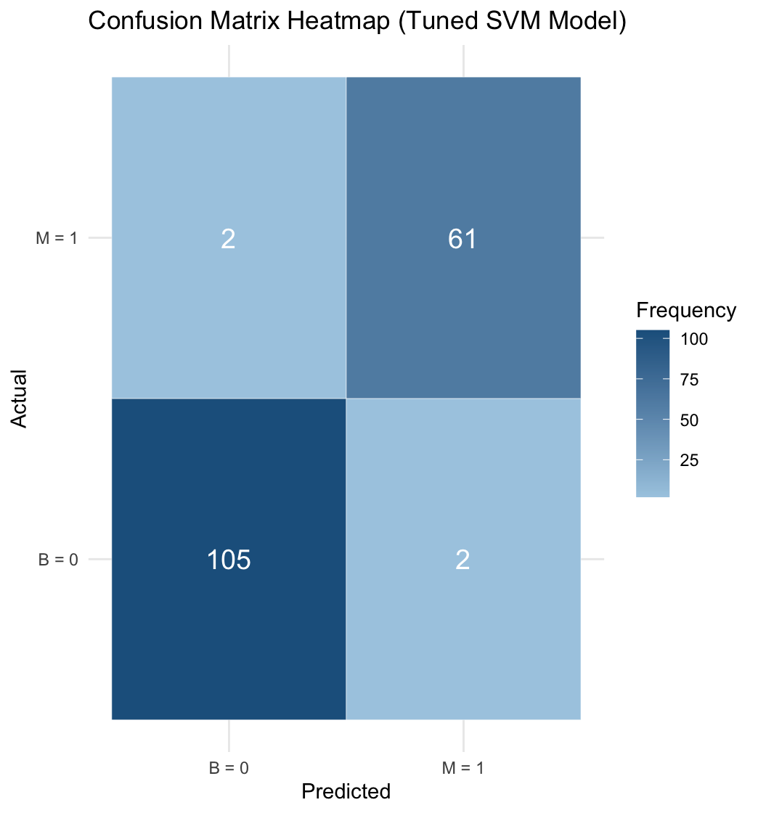
Support Vector Machine (Linear)
Objective: Classify data using SVM, optimized using best kernel identification and hyperparameter fine tuning with features selected by LASSO.
Optimization:
Used 10-fold cross validation to find best parameters with best performance
Best Kernel: linear, Parameters: cost = 6
Performance Metrics:
Accuracy: 0.9764706
Sensitivity (Recall) : 0.968254
Precision: 0.968254
F1- score: 0.968254
Notes:
Om Gor: We used a Support Vector Machine model to classify our data, optimizing performance through hyperparameter tuning and feature selection with LASSO regression. Using 10-fold cross-validation, we determined the best configuration to be linear kernel with a cost parameter of 6. This setup achieved great results, with an accuracy of 97.65%. Sensitivity of 0.968, precision of 0.968. Since the sensitivity and precision values were the same, the f1-score is also 0.968.

Slide 11
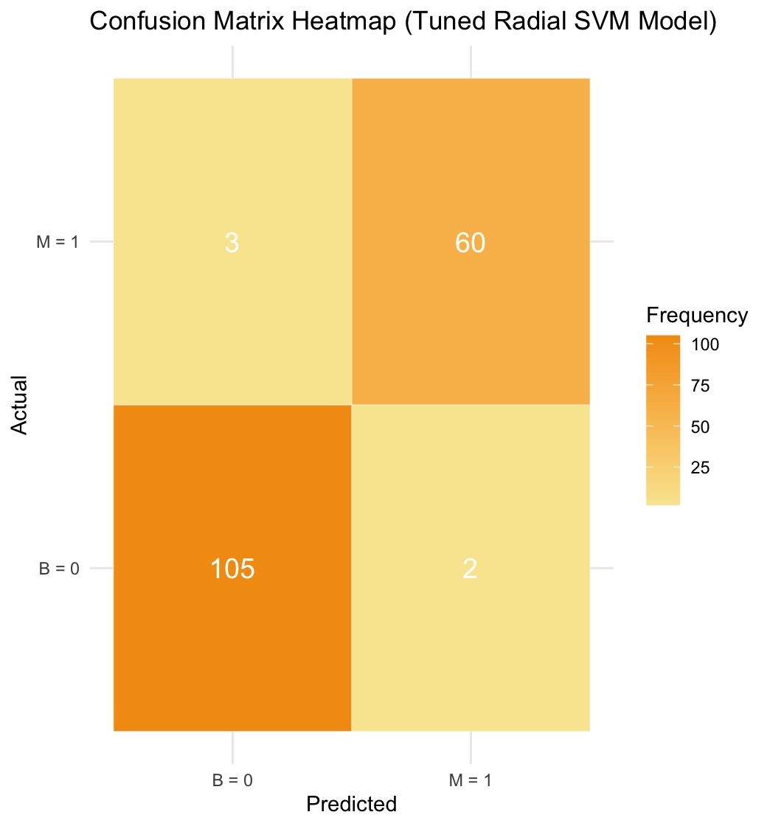
Support Vector Machine (Radial)
Objective: Classify data using SVM, optimized using best kernel identification and hyperparameter fine tuning with features selected by LASSO.
Optimization:
Used 10-fold cross validation to find best parameters with best performance
Kernel: Radial, Parameters: cost = 3, coef.0 = -1, gamma = 0.125
Performance Metrics:
Accuracy: 0.9705882
Sensitivity (Recall) : 0.952381
Precision: 0.9677419
F1- score: 0.96
Notes:
Om Gor: We used a radial kernel in SVM with LASSO regression to classify diagnosis. We decided to include this as it had similar performance compared with the linear model. Using 10-fold cross-validation, we identified the optimal configuration to be cost = 3, coef.0 = -1, and gamma = 0.125. Using this setup for radial kernel we achieved a strong accuracy of 97.06% which is slightly lower than the SVM linear kernel model. This model demonstrated good sensitivity of 95% for identifying positive cases and strong precision around 97% to minimize false positives. We also had a f1 score of 0.96.

Slide 12
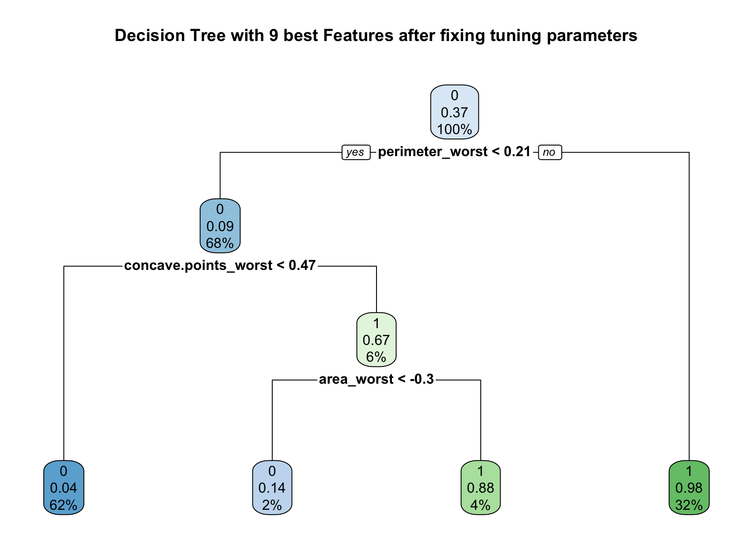
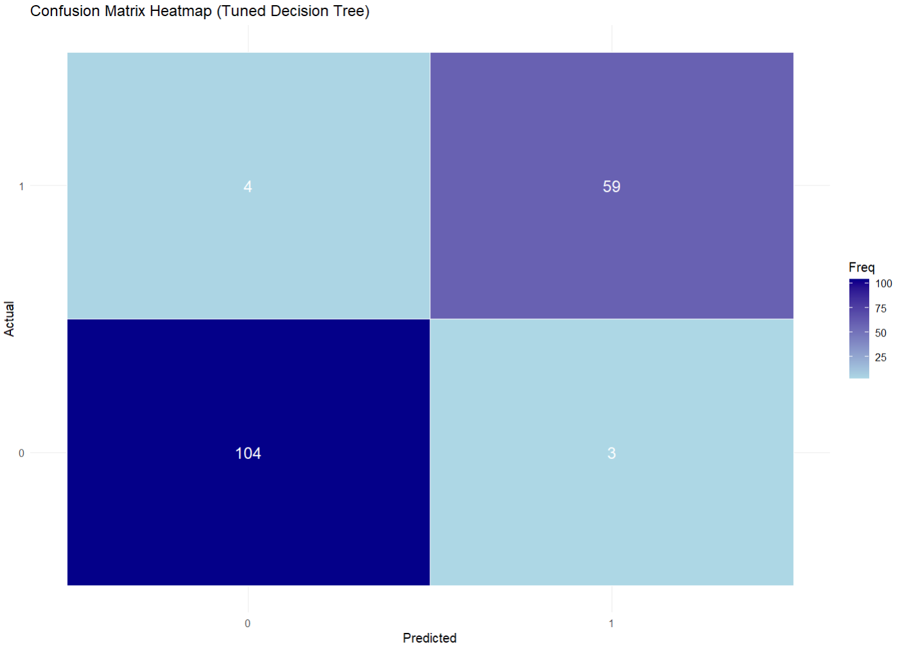
Decision Tree
Optimization:
Used 10-fold cross validation to find best parameters with best performance
Best Parameters: minsplit = 20, cp = 0.0001, and maxdepth = 5.
Performance Metrics:
Accuracy: 0.9588235
Sensitivity (Recall) : 0.9365079
Precision: 0.9516129
F1- score: 0.944
Notes:
Matt

Slide 13
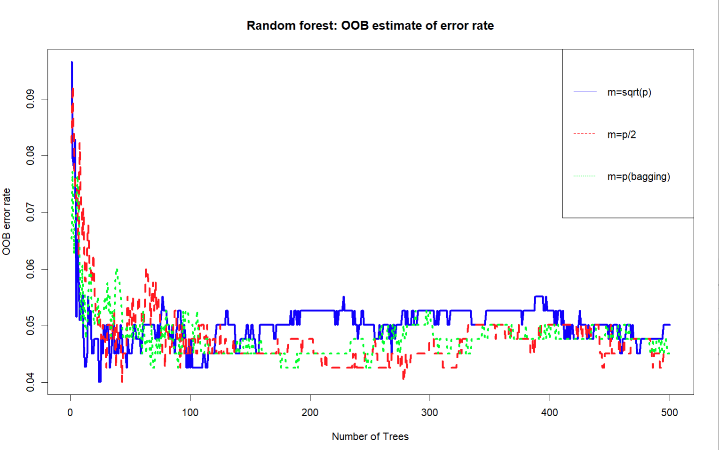
Choosing the best Random Forest Model
Objective: Classify data using a random forest model, optimized using best model and hyperparameter fine tuning with features selected by lasso. These are the models before any tuning procedures have been done.
Models: Bagging (m=p), m = √p, and m = p/2
Notes:
Matt

Slide 14
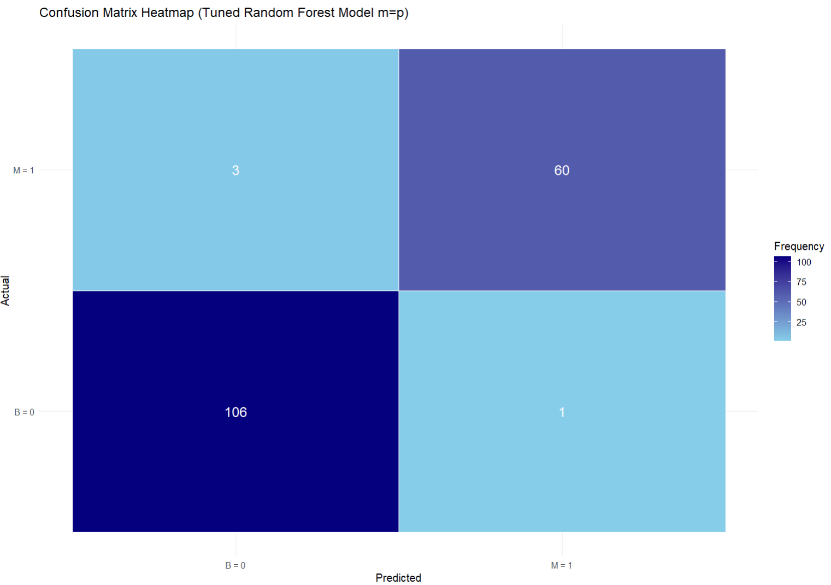
Best Random Forest Model: Bagging (m =p)
Optimization:
After using 10-fold cross validation we ended up finding best model with best performance to be the
Best Parameters:
mtry = 9
ntree = 200
Performance Metrics after tuning:
Accuracy: 0.9764706
Sensitivity (Recall) : 0.952381
Precision: 0.9836066
F1- score: 0.9677419
Notes:
Matt

Slide 15
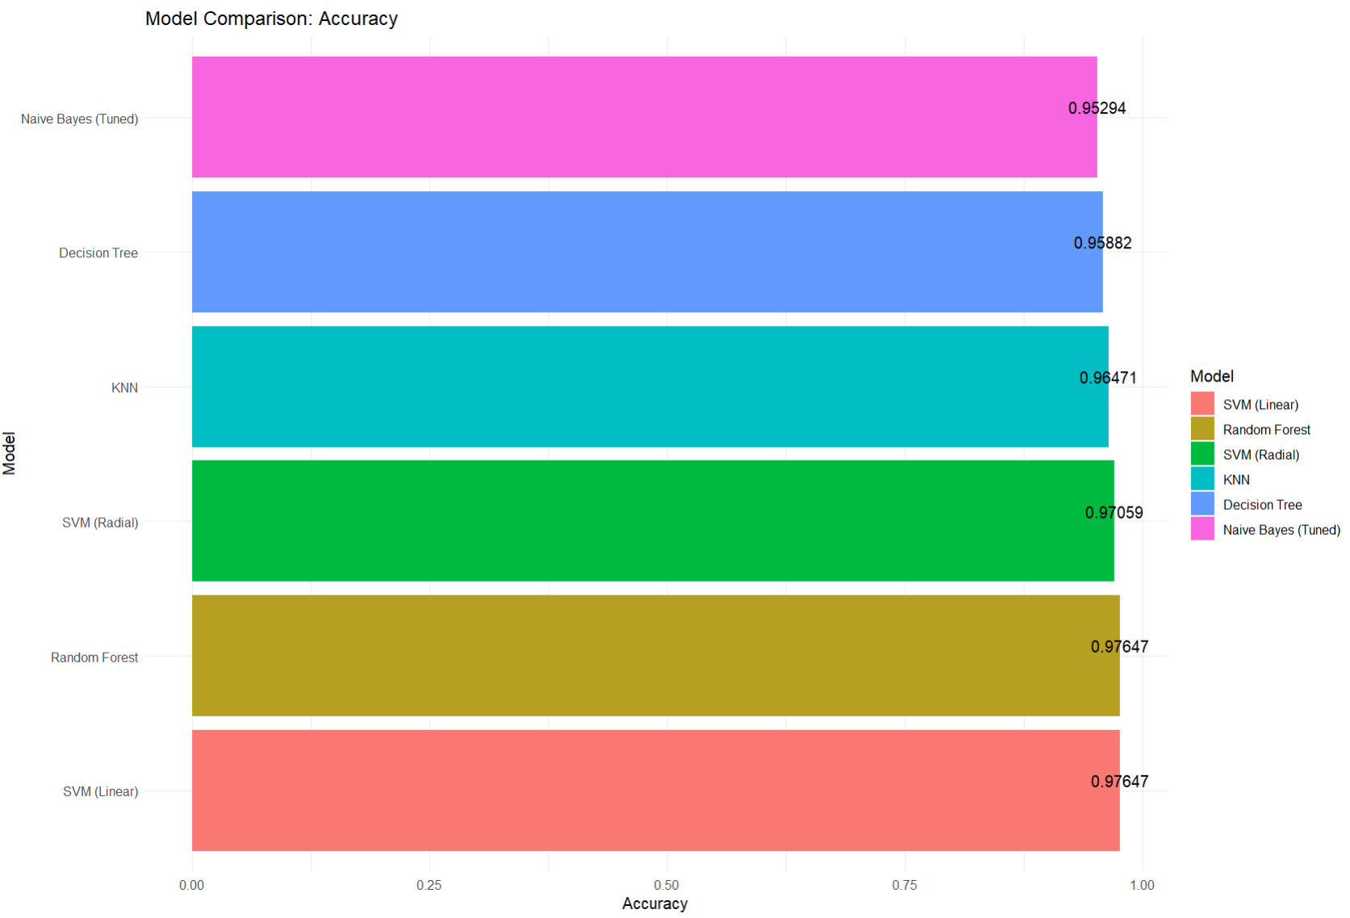
Conclusion: (SVM>>>)
Model | Accuracy | Sensitivity | Precision | F1 Score
LASSO | 0.9706 | 0.9365 | 0.9833 | 0.9593
KNN | 0.9647 | 0.9047 | 1 | 0.95
Naive Bayes | 0.9529 | 0.9824 | 0.8889 | 0.9334
SVM (Linear) | 0.9765 | 0.9682 | 0.9813 | 0.9682
SVM (Radial) | 0.9706 | 0.9524 | 0.9814 | 0.96
Decision Tree | 0.9588 | 0.9365 | 0.9516 | 0.944
Random Forest (Bagging) | 0.9765 | 0.9524 | 0.9836 | 0.9677
Given the metrics we found, we’ve come to a conclusion that the best performing model for predicting whether breast cancer diagnosis is benign or malignant in Wisconsin is the svm model with a linear kernel as it tied for scoring the highest accuracy with the random forest bagging model (0.97647) but had the slight edge over the random forest bagging model and scored the highest f1 score (0.9682) to show that it had the best overall model with the best trade off between precision and sensitivity(recall) rather than prioritizing either one of the metrics.
Notes:
Matt

Slide 16

Questions?

